Slide 1
Object Oriented Programming in C++
Nepal College of Information Technology
Course Instructor: Er. Rabina Chaudhary

Slide 2
Chapter 1:
Thinking Object Oriented

Slide 3
Object Oriented Programming
Programming model which is based upon the concept of objects
Programs are organized as cooperative collections of objects, each of which represents an instance of some class
Importance is given to data rather than the algorithm
Data and functions are tied together
Data protection or security of data is achieved by data hiding using access specifiers
Uses bottom up approach in program design

Slide 4
Characteristics of Object Oriented Programming
Classes
Object
Encapsulation
Inheritance
Polymorphism
Data Abstraction
Message Passing

Slide 5
Characteristics of Object Oriented Programming
1. Object :
Real world entities
Object is entity that has characteristics and behavior
Object is instance of a class
-If Ram is a Student than
He has characteristics like name, address, registrationNumber, marks
He has behavior like studying, taking exam, doing assignment

Slide 6
Characteristics of Object Oriented Programming
2. Classes :
A group of objects that share common characteristics and behavior
Example: Student
Student
Data : name rollNumber registrationNumber emailAddress Function : study() doAssignment() takeExam()

Slide 7
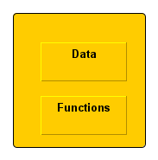
Characteristics of Object Oriented Programming
3. Encapsulation :
Binding together the data and functions
Prevents the data from unauthorized access

Slide 8
Characteristics of Object Oriented Programming
4. Inheritance :
Ability to create new classes from the already existing class
The existing class is called base class and the new class is called derived class
Property of base class is inherited by derived class
Derived class has data and functions of its parent class as well as its own data and functions
Inheritance supports reusability

Slide 9
Characteristics of Object Oriented Programming
5. Data Abstraction:
Abstraction refers representing only essential features or information and hiding background details
6. Polymorphism:
Polymorphism means having many form
Polymorphism can be achieved through function overloading and operator overloading

Slide 10
Characteristics of Object Oriented Programming
7. Message Passing :
Objects communicate with each other by sending and receiving information to each other to perform certain task
Message for an object is a request for execution of a procedure
Invoke the function in receiving object that generates the desired result
Object.functionName(information)

Slide 11
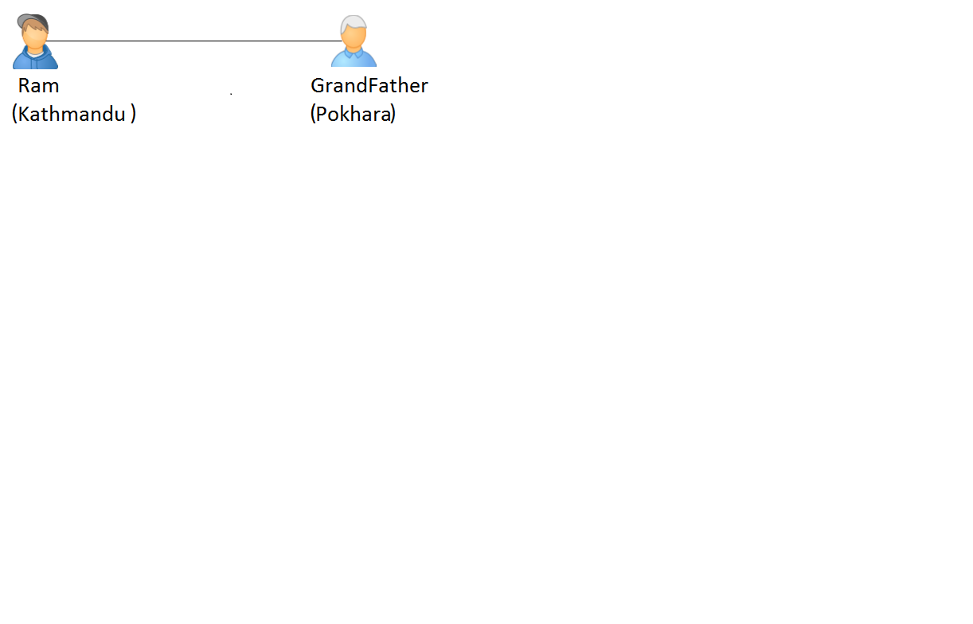
A way of viewing the world: Ram who lives in Kathmandu wants to send flowers to his grandfather who is in Pokhara.

Slide 12
A way of viewing the world:
Ram logins to “FlowersNepal” application.
Ram tells FlowersNepal kinds of flowers and address to which the flowers needs to be delivered
Ram makes payment and can be assured that flowers will be delivered as expected
To solve the problem, the mechanism we used to was find an appropriate agent( FlowersNepal) and passed the agent a message containing request.
After that it is the responsibility of FlowersNepal to satisfy the request.

Slide 13
A way of viewing the world:
FlowersNepal may have some sets of operations to do this. But Ram doesn’t need to know what methods or operations.
This information is usually hidden
Now, FlowersNepal will send a message to a florist in Pokhara with another message.
Florist in Pokhara may have obtained the flowers from flower wholesaler who in turn had interactions with flower growers
Florist in Pokhara passes the flowers to a delivery person with another message and so on.

Slide 14
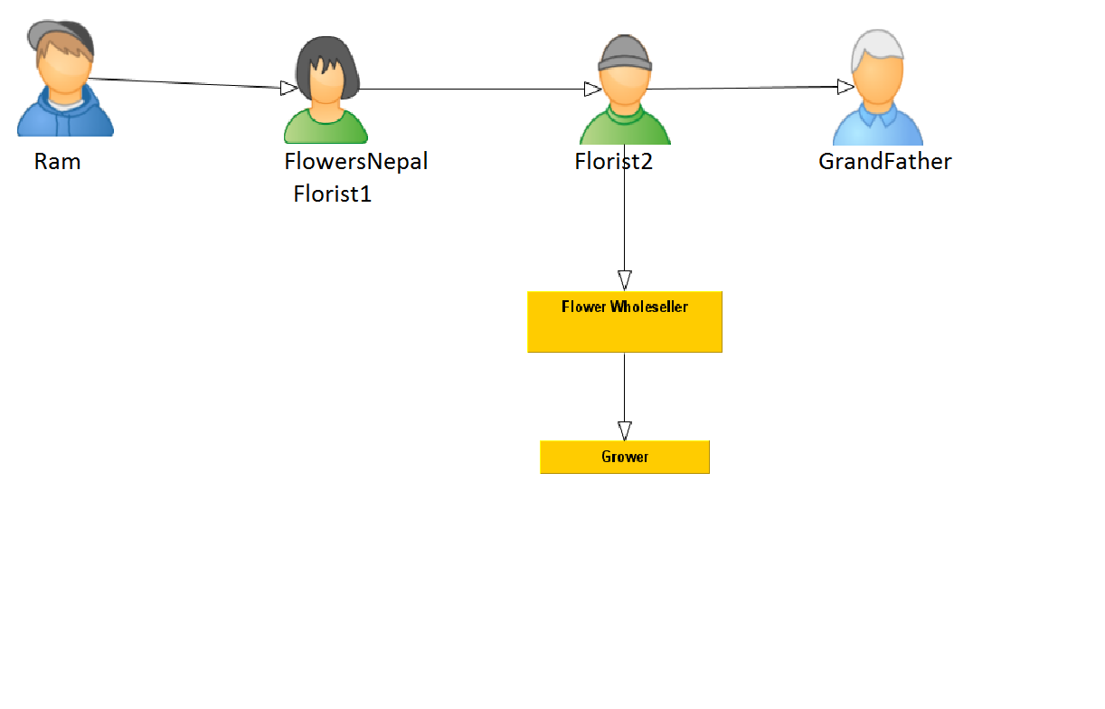
Community of agents helping delivery of flowers

Slide 15
A way of viewing the world:
Message and methods:
The chain of message that started from request given by Ram to “FlowersNepal” to solve Ram’s problem. This request lead to other requests which lead to more requests until flowers reached Grandfather.
Next principle of OOP is transmitting of a message to an agent(an object) responsible for action

Slide 16
A way of viewing the world:
Ram requests for action and he only wants desired outcome that is flowers sent to GrandFather.
FlowersNepal can choose any technique to achieve desired objective and it will not get any interference from Ram.
By discussing the problem in terms of responsibilities, we increase the level of abstraction. This permits greater independence between objects which is important to solve complex problems

Slide 17
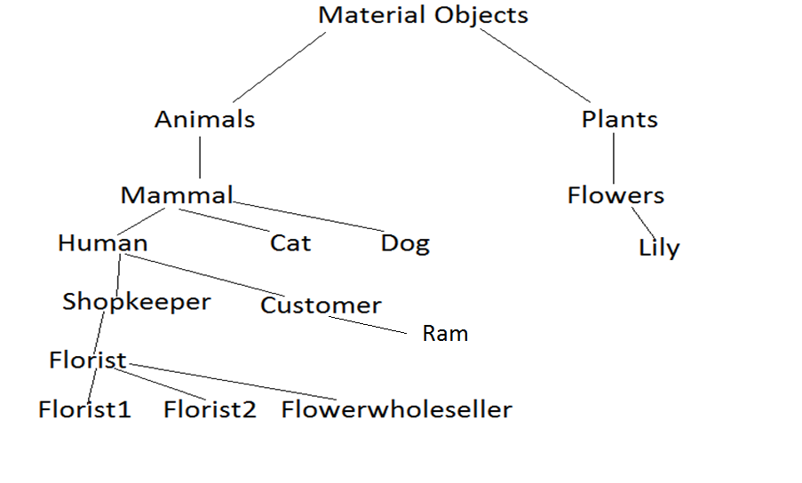
Class hierarchy

Slide 18
Alan Kay’s Definition of Object Oriented Programming
Everything is an object.
Computation is performed by objects communicating with each other through message passing.
Each object has its own memory.
Every object is an instance of a class. A class simply represents a grouping of similar objects.
The class is the repository for behavior associated with an object. That is, all the objects that are instances of same class can perform the same actions.
Classes are organized into a singly rooted tree structure called inheritance hierarchy.

Slide 19
Computation as Simulation
In discrete event driven simulation the user creates computer models of various elements of the simulation, describes how they will interact with one another and sets them moving.
This is almost identical to Object Oriented Programming in which the user describes what the various entities in the program are, how will they interact with one another and finally set them in motion.
Thus OOP we have the view that computation is simulation.

Slide 20
Coping with Complexity The non-linear behavior of complexity
A task that would take one programmer two months to complete could not be accomplished by two programmers working for one month.
The reason for this non-linear behavior is complexity which are
1. the interconnection between software components are complicated
2. a large amount of information has to be communicated among various members of the programming team

Slide 21
Abstraction
Abstraction is used to control the complexity
Abstraction means showing only essential attributes and hiding unnecessary information
It is hiding unwanted details and showing only most essential information

Slide 22
Abstraction Mechanism
Procedure and function
Block Scope
Modules
Abstract Data Type
Object

Slide 23
Abstraction Mechanism
1. Function
-one of the first abstraction mechanism used in programming language
- function allows to write a set of code to perform a task and when ever you need to perform that task, we can simply call the function rather than writing same code multiple times
-Libraries of function gave the first possibility of information hiding where one programmer could write a set of procedures which could be used by many others.
-The other programmer would only know the necessary interface and not know the exact details of implementation.
- A function abstraction works by allowing the programmer to call a function written by the another programmer without necessarily understanding how it is implemented.

Slide 24
Procedure and function
int a,b;
void input()
{
……
}
void add()
{
……
}

Slide 25
Abstraction Mechanism
2. Block Scope:
Block scope determines the visibility or accessibility of the block
When we use { }, it is a block. So, if we declare variables in the block scope, it means those variables exist only within the corresponding block

Slide 26
2. Block Scope:
Nesting of function
In nesting of function, one function is nested within another function
void add(int x,int y)
{
…
}
void input()
{
int a,b;
add(a,b);
}

Slide 27
Abstraction Mechanism
3. Modules :
Large programs can be broken into modules
The programmers can think about the implementation of a piece of a program without full knowledge of the rest of the programs
The rest of the programs needs to be understood only abstractly

Slide 28
3. Modules :
David Parnas’ principle for modules are
The development module must be provided with all information needed to complete the module and nothing more.
The developer of a module must provide the intended user with all the information to use the module correctly and nothing more.

Slide 29
Abstraction Mechanism
4. Abstract Data Type:
Abstract data type is user defined data type or class whose properties is defined by set of values and set of operations
ADT helps us to group data members and member functions
It can decide which data members will be visible to which parts of programs
It prevents user from directly accessing the private members

Slide 30
Abstract data type
5. Object
Objects provide abstraction by hiding internal implementation details
We just need to know which methods of the object are available to call and which input parameters we need to pass do specific operation
We don’t need to understand how the method is implemented and what kinds of operations the method has to perform to create the expected result
It has message passing feature

Slide 31
End of Chapter 1

